Slide 1

How Does Cyberslacking Increase Organization’s Security Risk?
Group 03
Course Title: Management Information System
Course No: BUS 528
Course Teacher: Dr. Najmul Hasan

Slide 2

Group 03
Name | ID
Jakia Quamrun Nahar Nafe Muhtasim Hye | 18364028 23364060
Samin Yaser Noman Jemima Farhin | 23364021 20264019
Qazi Tamanna Tarannum Rashid Masrur-As-Sami | 21364107 24164037

Slide 3
Introduction
Cyberslacking, refers to the practice of employees using their work computers or internet access for personal activities during work hours, rather than focusing on their job-related tasks
This behavior can have negative consequences for both the employee and the organization

Slide 4
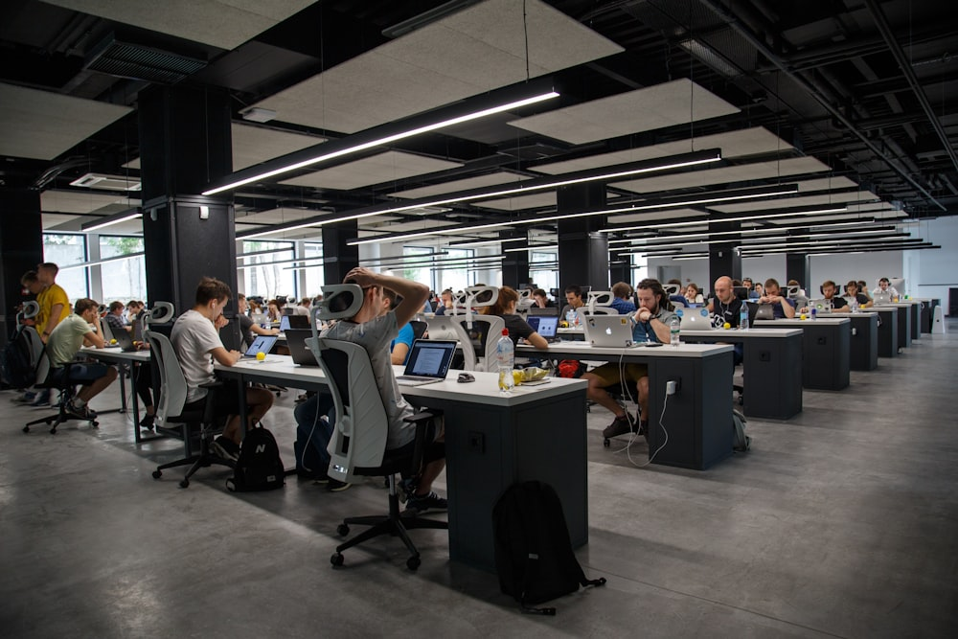
Factors Contributing to Cyberslacking

Slide 5
Boredom
Employees may engage in cyberslacking when they feel bored or unmotivated with their tasks
When work becomes monotonous or lacks challenge, individuals may seek entertainment or distraction online to alleviate boredom

Slide 6

Lack of Job Satisfaction
Dissatisfaction with one's job can lead to increased cyberslacking behavior.
Employees who feel undervalued, unfulfilled, or disconnected from their work may turn to online activities as a means of escape or coping mechanism.

Slide 7

Easy Access to the Internet
The widespread availability and accessibility of the internet in the workplace make it convenient for employees to engage in cyberslacking activities.
With smartphones, laptops, and other devices connected to the internet, employees can easily access non-work-related websites and apps.

Slide 8

Perception of Harmlessness
Some employees may perceive cyberslacking as a harmless activity, especially if they believe it does not directly impact their job performance or the organization

Slide 9

Activities which lead to various negative consequences for the organizational

Slide 10

Increased Costs
When employees spend work time on personal online activities, it reduces their productivity, leading to wasted resources and potentially higher operational costs for the organization.

Slide 11


Security Risks
Engaging in inappropriate online activities can expose the organization's network to security threats such as malware, phishing attacks, or data breaches, putting sensitive information at risk.

Slide 12

Damage to Reputation
If employees are caught engaging in activities deemed inappropriate or unprofessional, it can damage the company's reputation both internally and externally.
Overall, addressing cyberslacking is important for maintaining productivity, security and the reputation of the organization.

Slide 13

Strategies for mitigating cyberslacking

Slide 14
Implementing policies
Establishing clear guidelines and rules regarding internet usage and acceptable online behavior within the organization
Keeping track of employees' online activities to ensure compliance with established policies and identify any misuse or excessive non-workrelated browsing

Slide 15
Monitoring internet usage
Keeping track of employees' online activities to ensure compliance with established policies and identify any misuse or excessive non-work related browsing.

Slide 16

Providing training on appropriate use of technology
Offering educational programs or workshops to help employees understand the proper and efficient use of technology tools and resources in the workplace

Slide 17

Fostering a work culture that emphasizes productivity
Cultivating an environment where productivity is valued and promoted, encouraging employees to stay focused on their tasks and avoid distractions, including excessive internet use for non-work purposes

Slide 18

Data Analysis

Slide 19
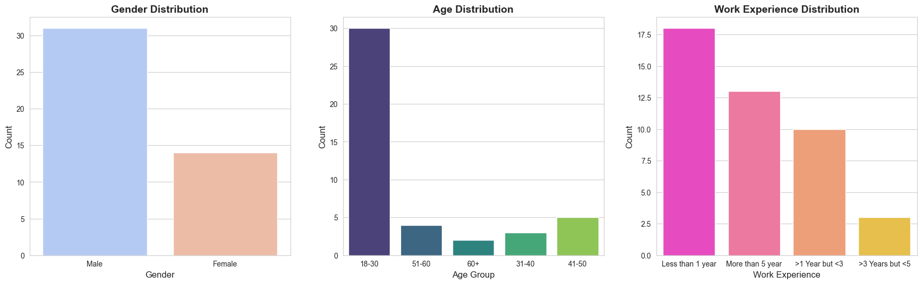
Distribution by Demographics
Gender: Predominantly Male (31 out of 45).
Age: Most respondents are in the 18-30 age group (30 out of 45).
Education: Majority have a post-graduate education (26 out of 45).
Monthly Income: Most earn below 25,000 BDT (17 out of 45).
Work Experience: A significant number have less than 1 year of experience (18 out of 44).

Slide 20
Data Manipulations
Main categories and variables available in the dataset
Environmental Factors:
Facilitating Condition
Subjective Norms
Organizational Justice
Personal Attitudes and Abilities:
Attitude toward Cyberslacking
Cyberslacking Self-Efficacy
Conscientiousness
Personality Traits
Work-Related Factors:
Job Stress
Outcome Variables:
Cyberslacking
Increased Security Risk
Demographic Variables:
Gender
Age
Education
Monthly Income
Work experience in business organization
Assign numerical values:
Strongly Agree / Agree = 1
Neither agree nor disagree = 2
Disagree / Strongly Disagree = 3
Calculate average values for each section based on the questionnaire responses.
Round the averages to the nearest whole number to reflect the categorical nature of responses.
Encode the remaining demographic variables using label encoding for each categorical variable.

Slide 21
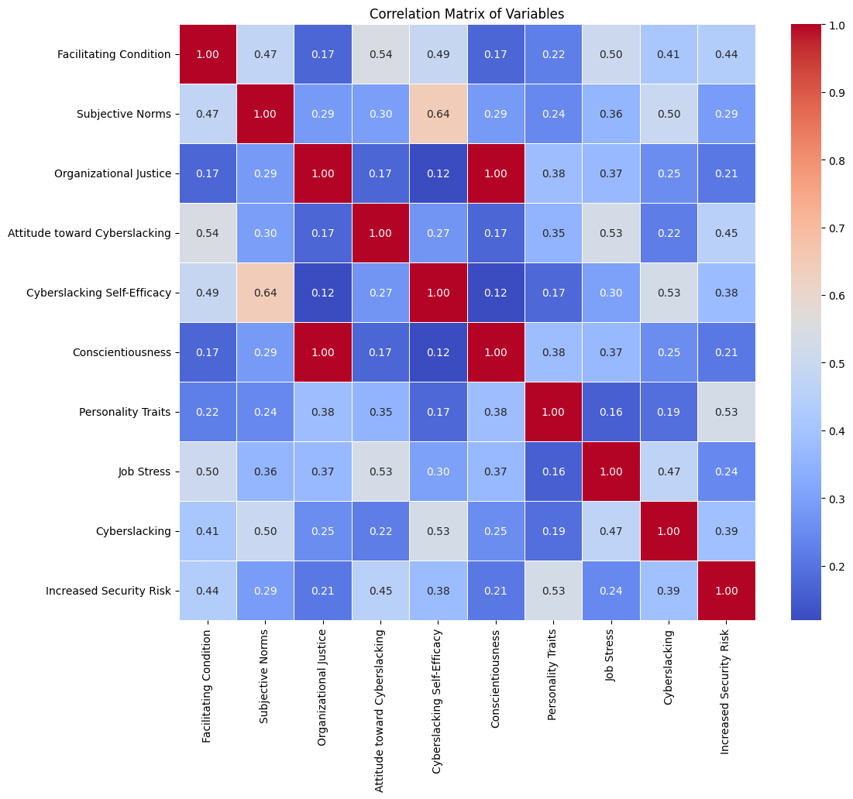
Correlation Analysis
Table 1: Correlations with Cyberslacking (Top 3 Factors)
Variable | Correlation with Cyberslacking
Cyberslacking Self-Efficacy | 0.53
Subjective Norms | 0.50
Job Stress | 0.47
Table 2: Correlations with Increased Security Risk (Top 3 Factors)
Variable | Correlation with Increased Security Risk
Personality Traits | 0.53
Attitude toward Cyberslacking | 0.45
Facilitating Condition | 0.44

Slide 22
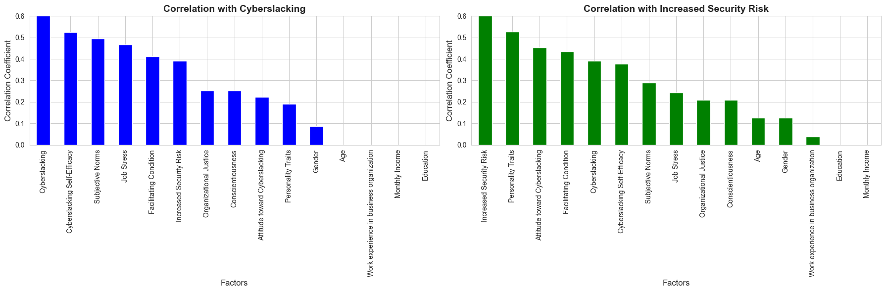
Correlation Analysis Results
Factors related to Cyberslacking:
Cyberslacking Self-Efficacy (0.53): Indicates a moderate positive correlation with cyberslacking behaviors.
Subjective Norms (0.50): These show positive correlations suggesting subjective norms influence cyberslacking.
Job Stress (0.47): Positively correlated, indicating that higher job stress may lead to more cyberslacking.
Factors related to Increased Security Risk:
Personality Traits (0.53): Moderate positive correlation, suggesting traits significantly influence perceived security risks.
Attitude toward Cyberslacking (0.45) and Facilitating Condition (0.44): Showing moderate positive correlations, linking both to increased security risks.

Slide 23

Recommendations from the Data Analysis
Reducing Cyberslacking and Mitigating Security Risks
Enhance Awareness and Training Programs
Strengthen Organizational Policies
Supportive Work Environment
Develop Personal Development Plans

Slide 24

THANK YOU
Presented By:
Jakia Quamrun Nahar
ID: 18364028
Nafe Muhtasim Hye
ID: 23364060
Samin Yaser Noman
ID: 23364021
Jemima Farhin
ID: 20264019
Qazi Tamanna Tarannum Rashid
ID: 21364107
Masrur-As-Sami
ID: 24164037
Group 03
Course Title: Management Information System
Course No: BUS528
Course Teacher: Dr. Najmul Hasan

